Slide 1
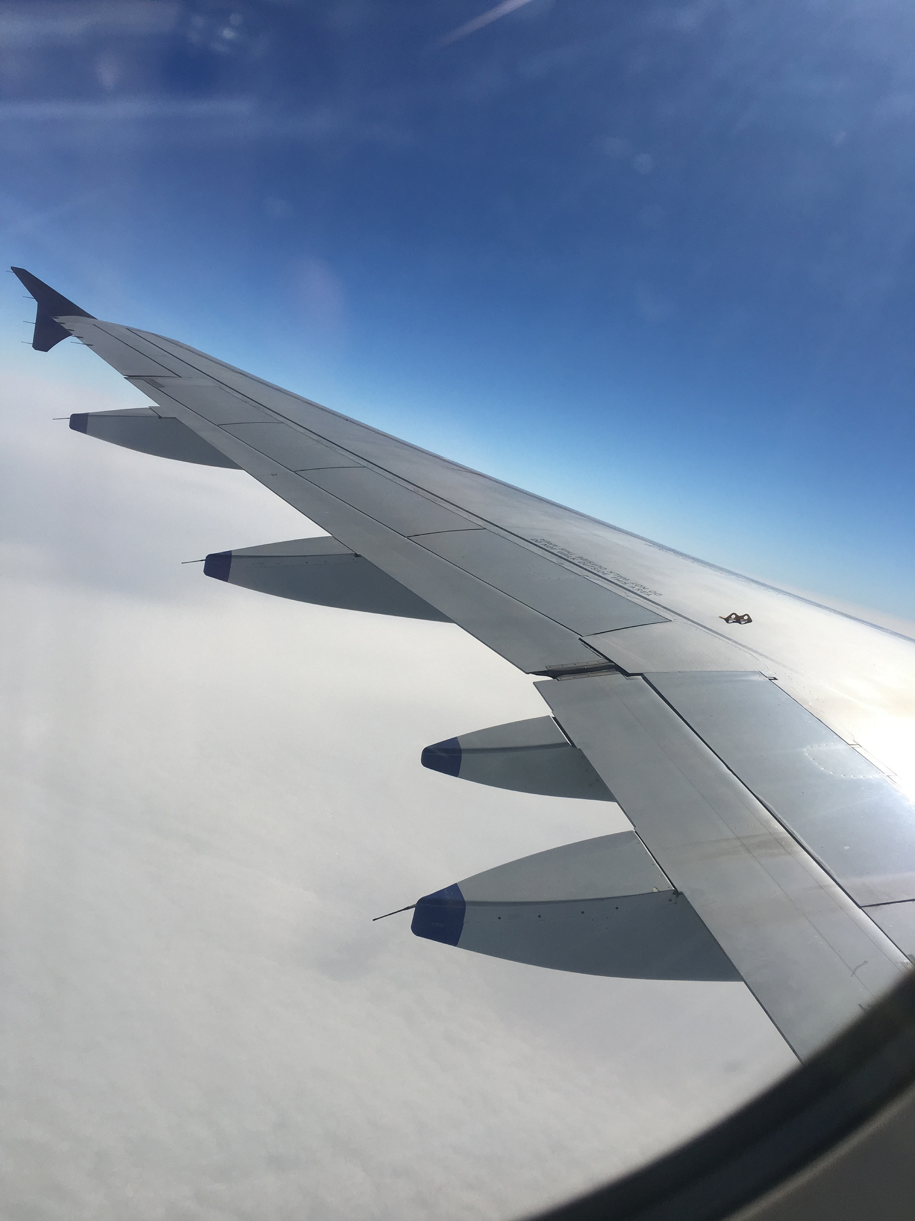
Evaluation only.
Created with Aspose.Slides for C++ 19.6.
Copyright 2004-2019Aspose Pty Ltd.

